Slide 1
Jenkins – The Basics
CI/CD Automation Tool
Manoj D
June 2020

Slide 2
Agenda
Jenkins Overview
Installation & Setup
Setup Build Jobs
Jenkins Pipeline
Jenkins Plugins

Slide 3
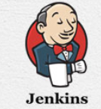
Jenkins Overview
Jenkins is an open source automation tool written in Java with plugins built for Continuous Integration and Continuous Delivery purpose.
It helps automate the parts of software development related to building, testing and deploying – facilitating continuous integration and continuous delivery.
Jenkins achieves Continuous Integration and Continuous Delivery with the help of plugins.
It is a server-based system that runs in servlet containers such as Apache Tomcat.
Jenkins can be deployed on Cloud - by getting cloud VM, installing & maintaining self or letting Cloud provider handle the administration. Compatible with Google cloud platform, AWS, Cloudbees, DigitalOcean, Servana, Microsoft Azure & Kamatera. Many support Pay as per usage model & has chargeback based on build run time & VM cost.

Slide 4
Advantages of Jenkins
It is an open source tool.
It does not require additional installations or components. Means it is easy to install.
Automated Build Process, triggered by Code Check-in/Commit
Early Detection of Errors & Bugs through Automated Testing (saves Manual Test Effort/Cost)
Greater Transparency among team members due to clear assessment of the process and why the tests are failing
Developer Time is focused on Business & not on Code Build/Deploy/Delivery
Frequent Integration & Release to Prod – brings Agility (increase in Time to Market)

Slide 5
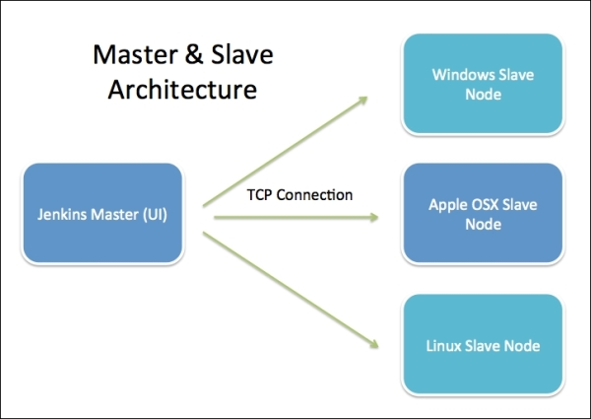
Jenkins Architecture
Jenkins uses master/slave architecture to manage distributed builds.
Distributed Jenkins Architecture has 2 components –
Jenkins Server
Jenkins Node/Slave/Build Server
Jenkins server is a web dashboard which is nothing but powered from a war file, default run on 8080 ports. Using Dashboard, You can configure the Jobs/Projects but the build takes place in Nodes/Slave. By default one Nodes/Slave is configured and running in Jenkins Server. You can add more Nodes/Slave as well using IP address, user name, Password using the ssh/jnlp/webstart methods.
Main Jenkins server is the master. In short, the master’s job is to handle scheduling build jobs, dispatching builds to the slaves for the actual execution, monitor the slaves (possibly taking them online and offline as required) and recording and presenting the build results.
The job of the slaves is to do as they are configured in the Jenkins Server, which involves executing build jobs dispatched by the master. You can configure a project to always run on a particular slave machine, or a particular type of slave machine, or simply let Jenkins pick the next available slave.

Slide 6
Fungible (replaceable) slaves & master-slave connectors and protocol
Fungible (replaceable) slaves
can configure third party tools to automatically install on slaves
best practice is to make slaves interchangeable, but can tie jobs to slaves
Master-slave connectors and protocol
ssh connector – preferred option. slaves need sshd server and public/private key
jnlp/tcp connector – java network launch protocol start web agent on slave through jws (java web start). can start via browser or os service
jnlp/http connector – like jnlp/tcp except headless and over http
custom script – launch via command line

Slide 7
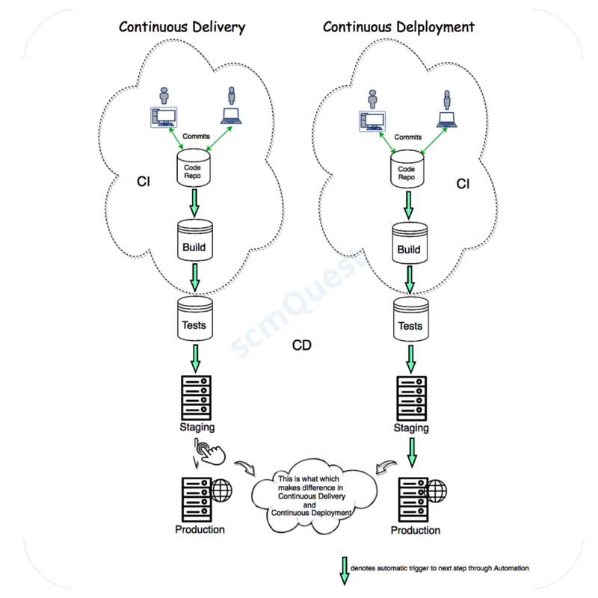
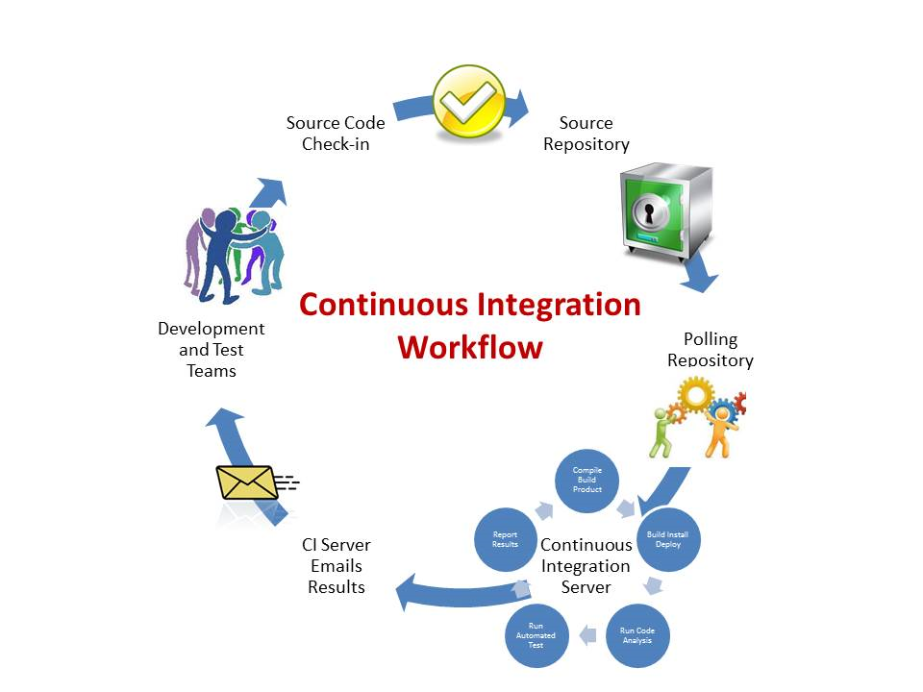
Stages in CI/CD

Slide 8
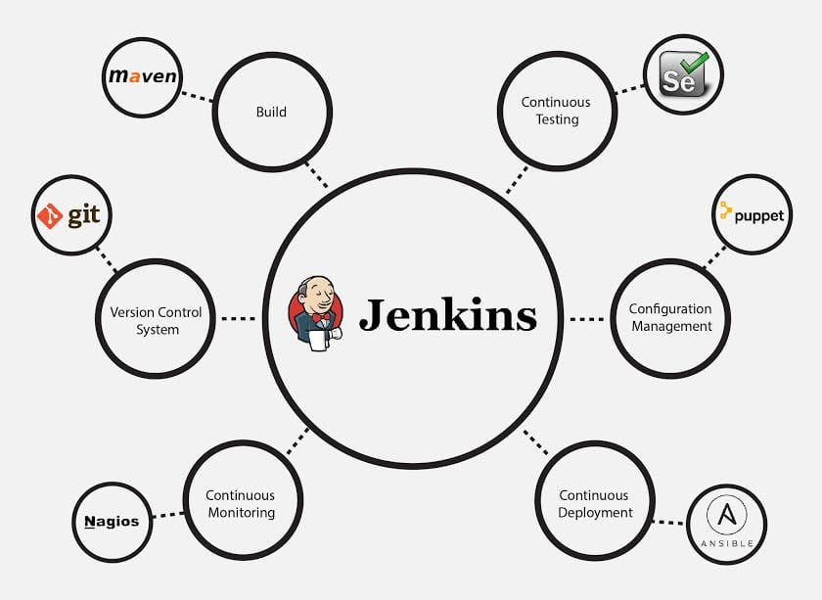
Typical CI/CD pipeline built in Jenkins
The image below depicts that Jenkins is integrating various DevOps stages:
2
3
1
Developers commit changes to the source code in SCM
tool – Git / GitHub. Every commit made in the repository triggers the build.
2
A maven build runs on the new changes.
3
Selenium executes its automated test scripts on
the newly created build & validates the build.
1
4
4
Deployment servers are configured & prepared for
deployment by Puppet
5
Tested Build is deployed in the prepared
environment by Ansible
6
6
Deployed Application can be monitored by Nagios
5

Slide 9
Installation & Setup
System Requirements
JDK | JDK 8.0 or 11.0
Memory | 16 GB
Disk Space | 500 GB
Operating System Version | Jenkins can be installed on Windows, Ubuntu/Debian, Red Hat/Fedora/CentOS, Mac OS X, openSUSE, FReeBSD, OpenBSD, Gentoo.
Java Container | The WAR file can be run in any container that supports Servlet 2.4/JSP 2.0 or later.(An example is Tomcat 9.0 or above).

Slide 10
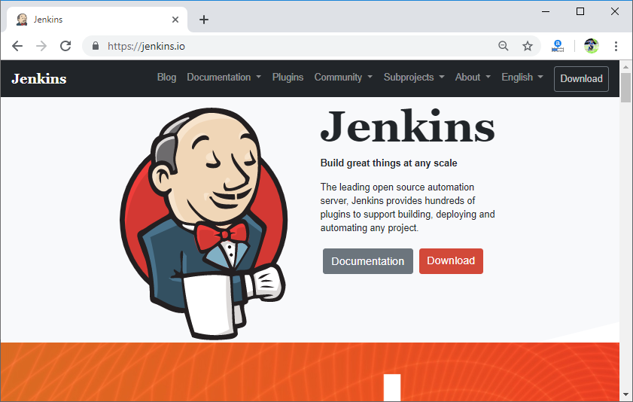
Installation & Setup
Download Jenkins war File. This war is required to install Jenkins.
The official website for Jenkins is https://jenkins.io/
When you click the given link, you will get the home page of the Jenkins official
website as given below:
Click on the Download button.

Slide 11
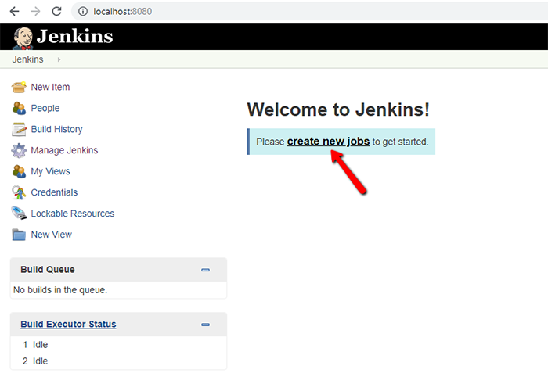
Installation & Setup
Accessing Jenkins
Now you can access the Jenkins. Open your browser and type the following url on your browser:
http://localhost:8080
This url will bring up the Jenkins dashboard.

Slide 12
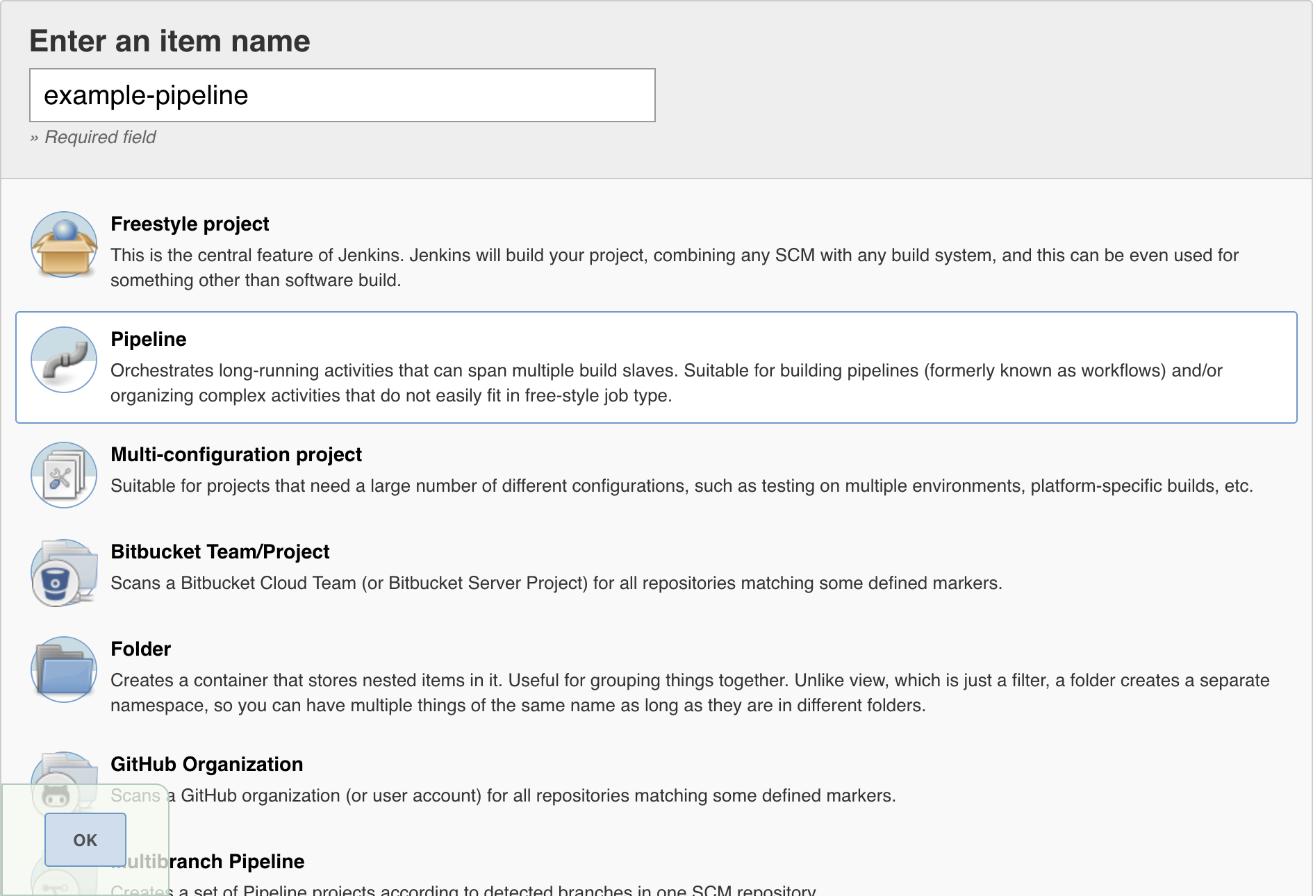
Types of Jenkins Jobs

Slide 13
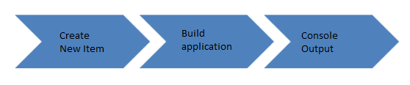
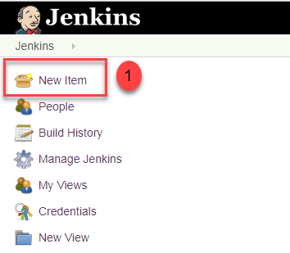
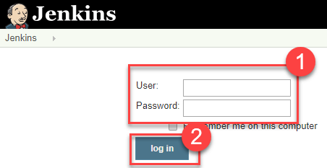
What is a Jenkins freestyle project?
A Jenkins project is a repeatable build job which contains steps and post-build actions. The types of actions you can perform in a build step or post-build action are quite limited. There are many standard plugins available within a Jenkins freestyle project to help you overcome this problem. They allow you to configure build triggers and offers project-based security for your Jenkins project.
Creating a Freestyle Build Job
The freestyle build job is a highly flexible and easy-to-use option. You can use it for any type of project; it is easy to set up, and many of its options appear in other build jobs.
Step 1) To create a Jenkins freestyle job, log on to your Jenkins dashboard by visiting your Jenkins installation path. Usually, it will be hosted on localhost at http://localhost:8080 If you have installed Jenkins in another path, use the appropriate URL to access your dashboard.
Step 2) Click on "New Item" at the top left-hand side of your dashboard.

Slide 14
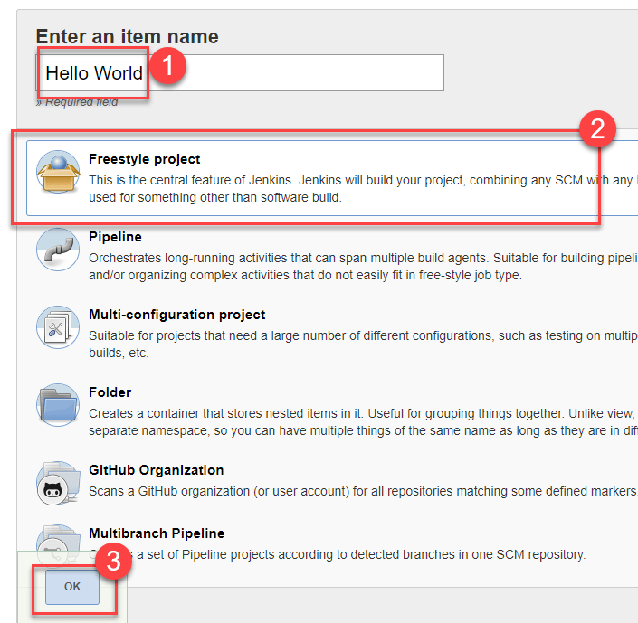
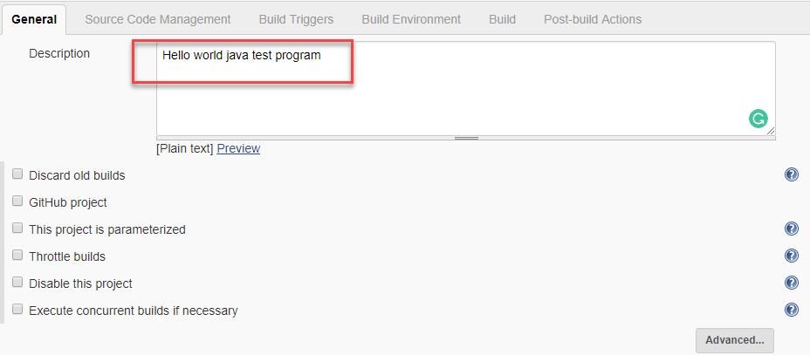
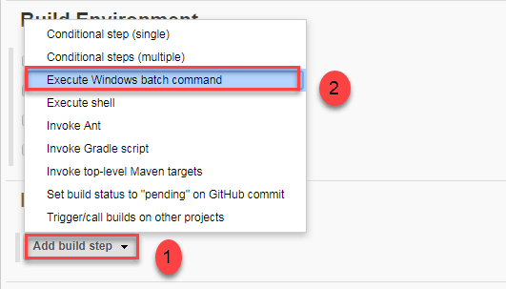
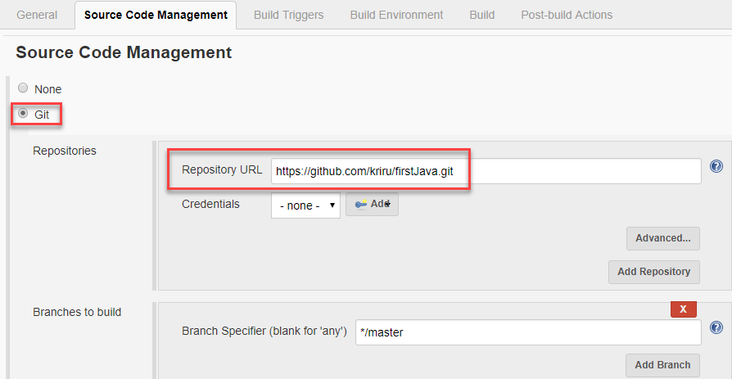
Step 3) In the next screen,
Enter the name of the item you want to create. We shall use the "Hello world" for this demo.Select Freestyle projectClick Okay.
Step 4) Enter the details of the project you want to test.
Step 6) Now that you have provided all the details, it's time to build the code. Tweak the settings under the build section to build the code at the time you want. You can even schedule the build to happen periodically, at set times.
Under build,
1. Click on "Add build step"
2. Click on "Execute Windows batch command" and add the commands you want to execute during the build process.
Step 5) Under Source Code Management, Enter your repository URL. We have a test repository located at https://github.com/kriru/firstJava.git

Slide 15
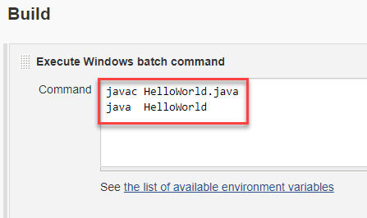
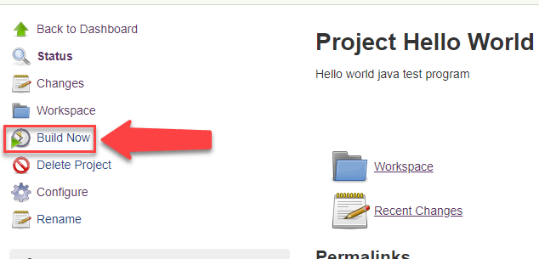
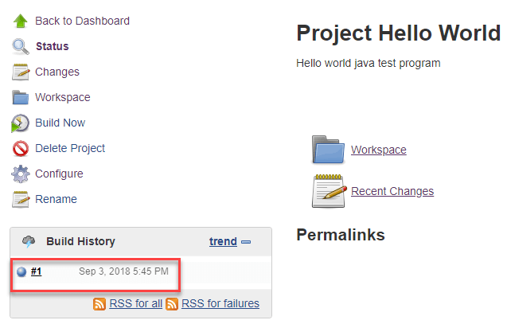
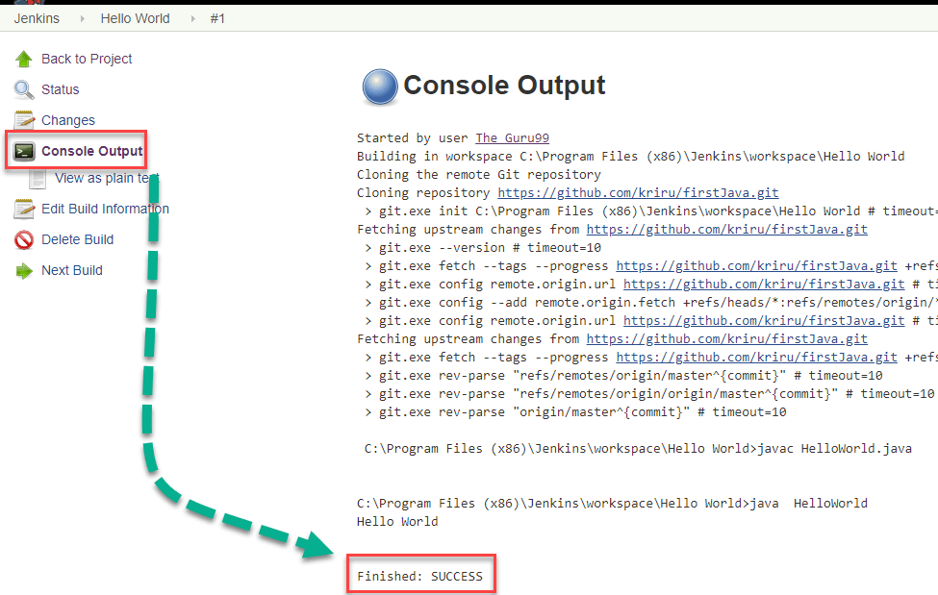
Here, I have added the java commands to compile the java code.
I have added the following windows commands:
javac HelloWorld.java
java HelloWorld
Step 7) When you have entered all the data,
Click Apply
Save the project.
Step 8) Now, in the main screen, Click the Build Now button on the left-hand side to build the source code.
Step 9) After clicking on Build now, you can see the status of the build you run under Build History.
Step 10) Click on the build number and then Click on console output to see the status of the build you run. It should show you a success message, provided you have followed the setup properly.
In sum, we have executed a HelloWorld program hosted on GitHub. Jenkin pulls the code from the remote repository and builds continuously at a frequency you define.

Slide 16
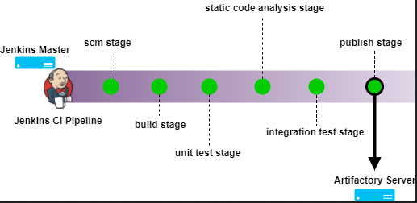
Jenkins Integrations

Slide 17
Jenkins Pipeline Concepts
Term | Description
Pipeline | The pipeline is a set of instructions given in the form of code for continuous delivery and consists of instructions needed for the entire build process. With pipeline, you can build, test, and deliver the application.
Node | The machine on which Jenkins runs is called a node. A node block is mainly used in scripted pipeline syntax.
Stage | A stage block contains a series of steps in a pipeline. That is, the build, test, and deploy processes all come together in a stage. Generally, a stage block is used to visualize the Jenkins pipeline process.
Step | A step is nothing but a single task that executes a specific process at a defined time. A pipeline involves a series of steps.

Slide 18
Declarative versus Scripted pipeline syntax:
There are two types of syntax used for defining your JenkinsFile.
Declarative
Scripted
Declarative
Scripted
Declarative pipeline syntax offers an easy way to create pipelines. It contains a predefined hierarchy to create Jenkins pipelines. It gives you the ability to control all aspects of a pipeline execution in a simple, straight-forward manner.
Scripted Jenkins pipeline runs on the Jenkins master with the help of a lightweight executor. It uses very few resources to translate the pipeline into atomic commands.

Slide 19
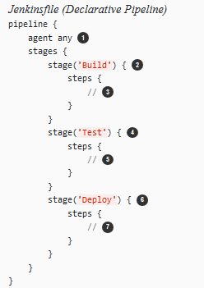
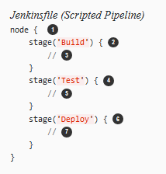
Pipeline as Code

Slide 20
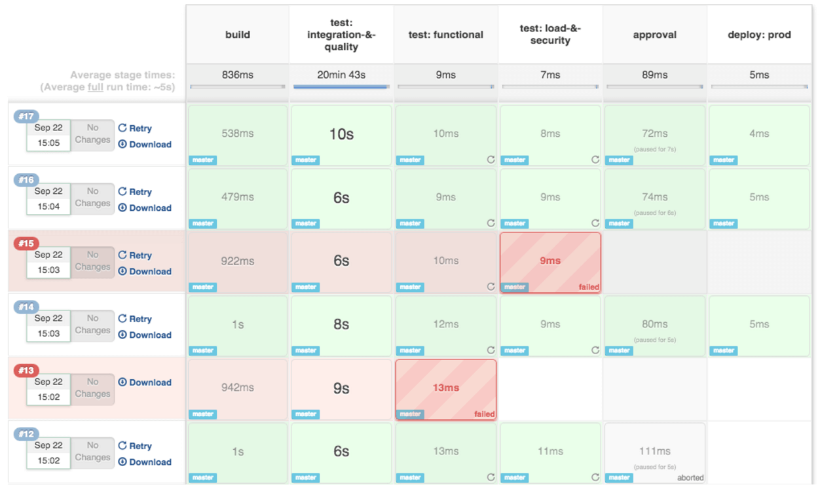
In real time projects, you will be responsible for creating and building complex pipelines in Jenkins. See below for a sample pipeline view.

Slide 21
Jenkins Plugins
Plugin | Purpose
Pipeline Plugin | Automates continuous delivery pipeline & allows to perform complex tasks using traditional plugins/freestyle projects itself.
Multijob plugin | Allows to express complex tasks & then organize them according to their structures in Jenkins. You can have phases with multiple jobs & also execute jobs in parallel to each other.
SCM API | Interacts with SCM tools + Event system to alert customers.
Git Plugin | Provides access to Git
GitHub Integration Plugin | To integrate Jenkins with GitHub
JaCoCo plugin | Integrates JaCoCo code coverage reports to Jenkins
Ansible plugin | Invokes Ansible ad-hoc commands & playbooks
JIRA Plugin | Integrates Jenkins to Atlassian JIRA

Slide 22
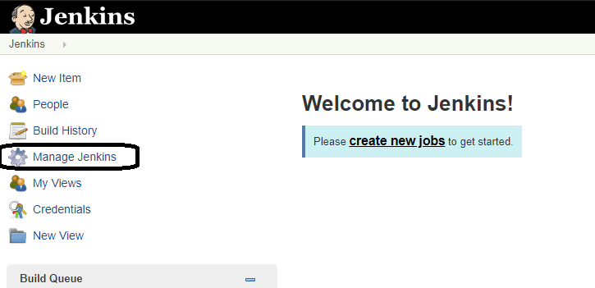
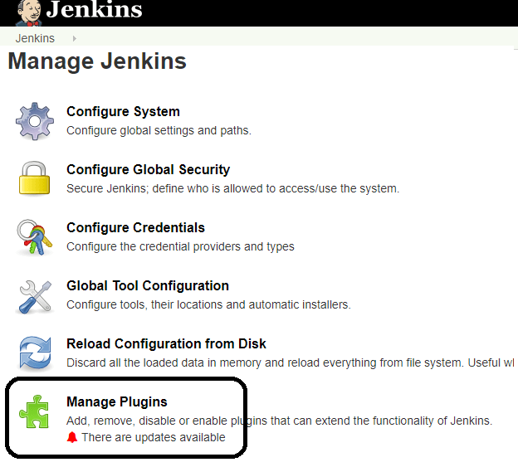
Jenkins – Git Setup
GitHub is a web-based repository of code with SCM features. Jenkins need GitHub plugin to be installed to pull code from GitHub repository.
Step 1: Click on the Manage Jenkins button on your Jenkins dashboard:
Step 2: Click on Manage Plugins:

Slide 23
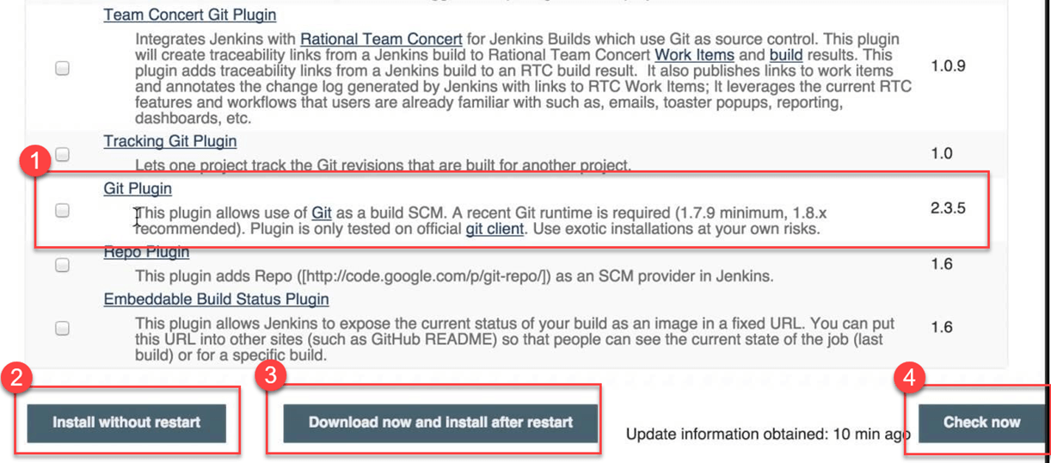
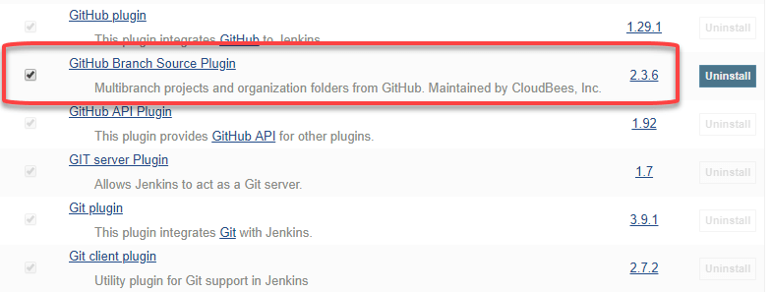
Step 3: In the Plugins Page
Select the GIT Plugin
Click on Install without restart. The plugin will take a few moments to finish downloading depending on your internet connection, and will be installed automatically.
You can also select the option Download now and Install after restart button. In which plugin is installed after restart
You will be shown a "No updates available" message if you already have the Git plugin installed.
Step 4: Once the plugins have been installed, go to Manage Jenkins on your
Jenkins dashboard. You will see your plugins listed among the rest.

Slide 24
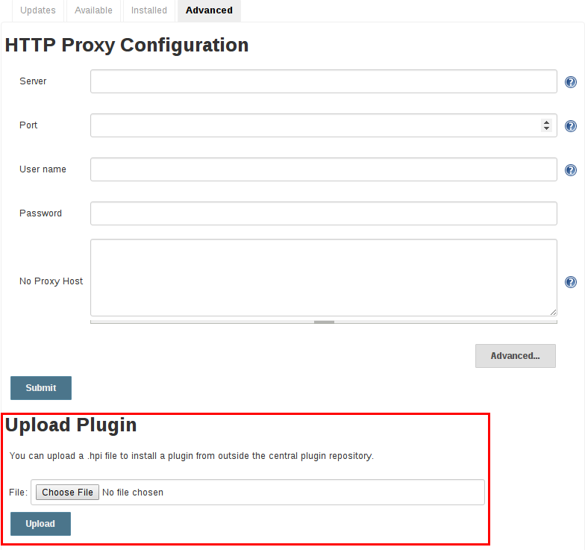
Advanced Installation of Plugin
From the web UI
Assuming a .hpi file has been downloaded, a logged-in Jenkins administrator may upload the file from within the web UI:
Navigate to the Manage Jenkins > Manage Plugins page in the web UI.
Click on the Advanced tab.
Choose the .hpi file under the Upload Plugin section.
4. Upload the plugin file.

Slide 25
Thank You
Manoj D - 670389
ManojReddy.D@cognizant.com

